Slide 1
Seller - Store Profile Page
Functional Requirements & Technical Requirements
KELOMPOK 7
Komang Yudi Utama (1915091006)
I Made Bagus Alviantara (1915091037)
Gede Agus Mahendra (1915091039)
I Putu Rizky Andika (1915091021)

Slide 2
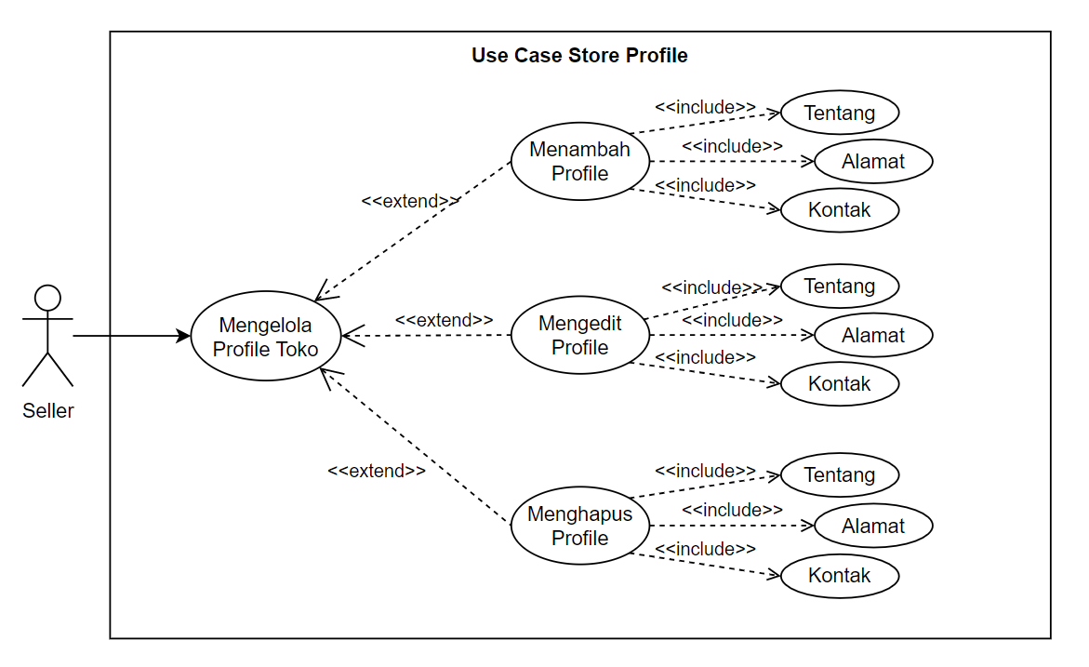
Functional Requirements
Use Case
Diagram

Slide 3
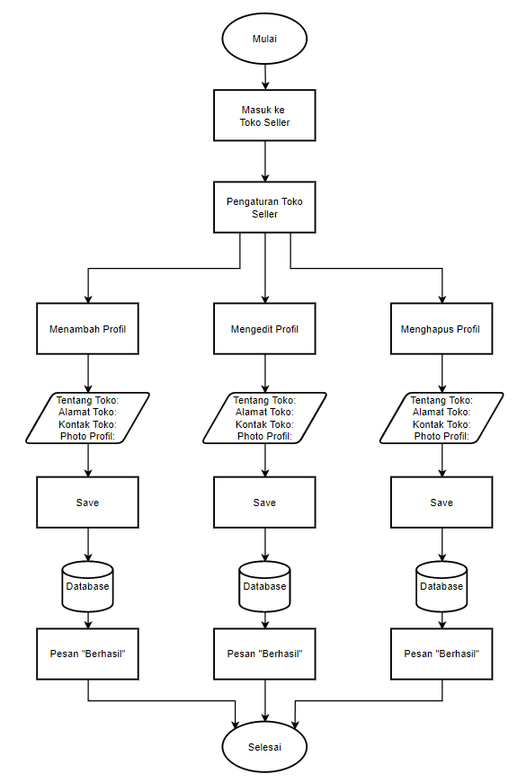
Functional Requirements
Flowchart
Diagram

Slide 4
Technical Requirements
Key | Name | Data Type | Max Length
PK | Kode Seller | varchar | 10
 | Nama Seller | varchar | 50
 | Jenis Usaha | varchar | 30
 | Jenis Kelamin | Enum | (“L”,”P”)
 | Kontak Telepon | varchar | 16
 | Alamat Seller | varchar | 50
 | Kode Admin | varchar | 10

Slide 5



Technical Requirements
HTTP Create
HTTP Update
API
HTTP Delete

Slide 6
THANKS

